Slide 1
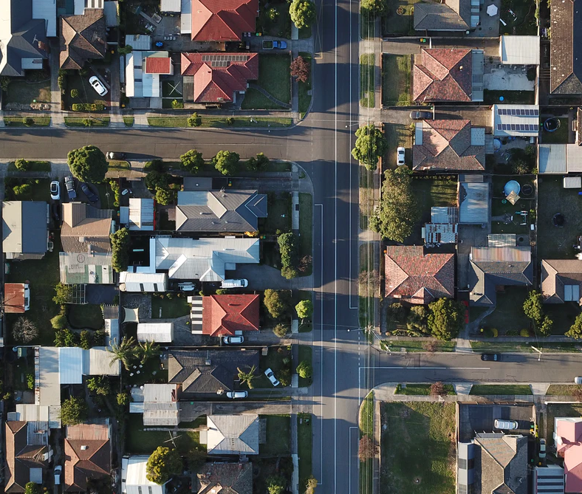
Analysis of Ames Housing data: Comparing Value of Cosmetic Features with Descriptive Modeling

Slide 2
Who We Are:
We are an IT-KASA (International Team KASA) organization tasked to evaluate Ames marketplace data and predict the price difference if certain cosmetic features were implemented.
Team Members:
- Khamanna
- Ariel
- Shay Agarwal
- Ava

Slide 3

Exploratory Data Analysis

Slide 4
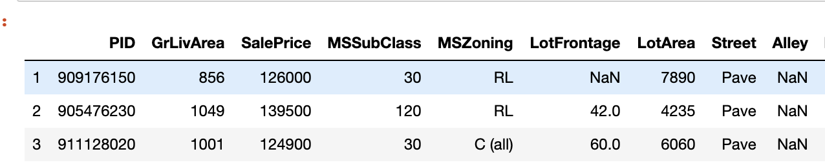
Exploratory Data Analysis:
 | Missing
PoolQC | 2571
MiscFeature | 2483
Alley | 2412
Fence | 2055
FireplaceQu | 1241
LotFrontage | 462
GarageFinish | 129
GarageQual | 129
GarageCond | 129
GarageType | 127
BsmtExposure | 71
BsmtFinType2 | 70
BsmtFinType1 | 69
BsmtCond | 69
BsmtQual | 69
MasVnrArea | 14
MasVnrType | 14
BsmtFullBath | 2
BsmtHalfBath | 2
Electrical | 1
BsmtUnfSF | 1
BsmtFinSF2 | 1
BsmtFinSF1 | 1
GarageCars | 1
TotalBsmtSF | 1
Removed Duplicate Rows
Removed Irrelevant observations – removed “PID”
Created a list of Variables with Missing Values and Cleaned It

Slide 5
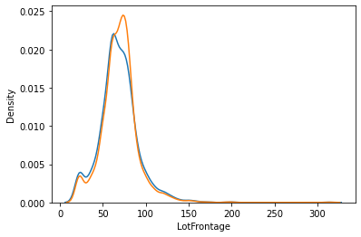
Exploratory Data Analysis:
” LotFrontage” distribution change after imputation
Impute Missing Values:
Impute Missing LotFrontage Values
Confirm the distribution of 'LotFrontage’ did not change significantly
Impute Missing Basement related Values
Impute Missing GarageArea and GarageCars Values
Impute Missing Electrical Values
Impute Missing MasVnrType and MasVnrArea Values
Check for Data Consistency: BsmtExposure (Basement Exposure)

Slide 6
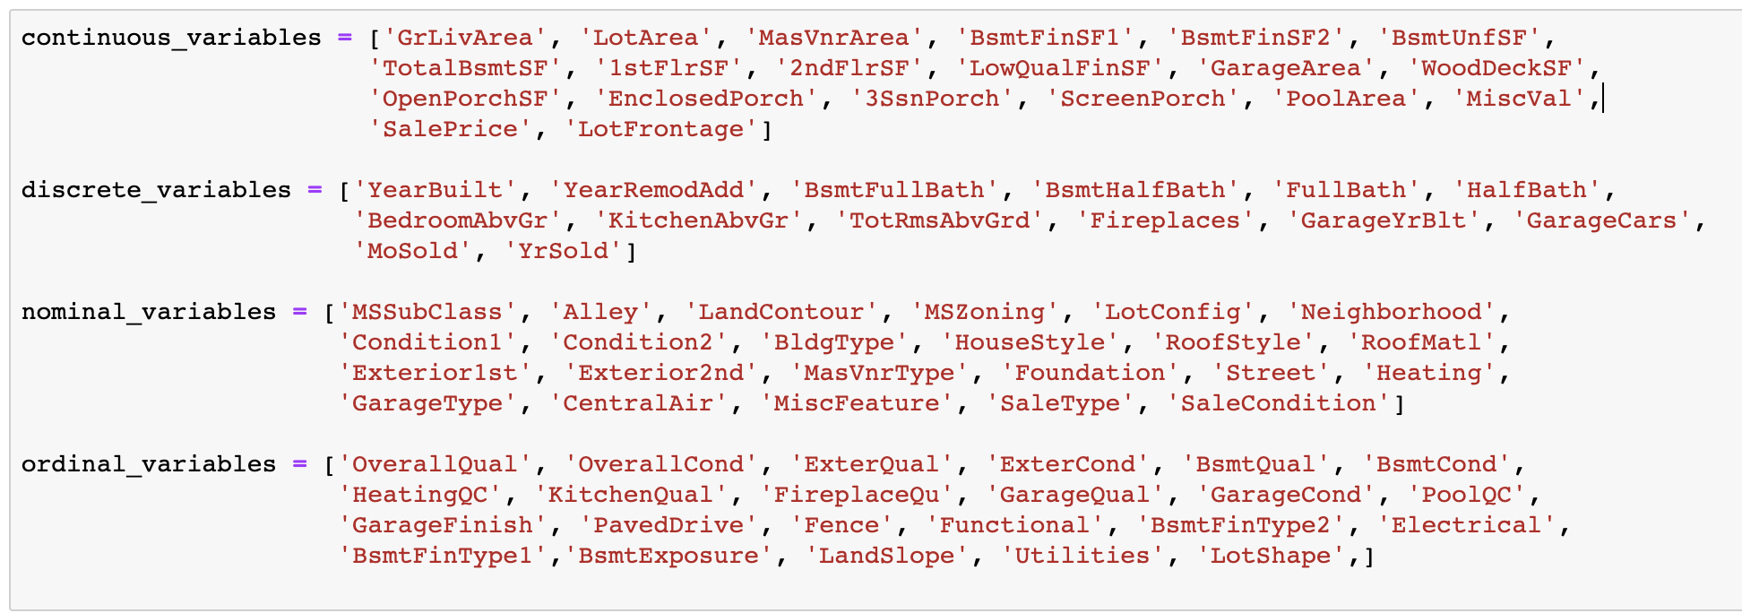
Exploratory Data Analysis:
Grouping Variables by type:
Continuous Variables
Discrete Variables
Nominal Variables
Ordinal Variables

Slide 7
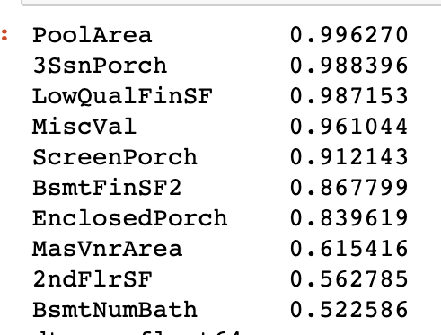
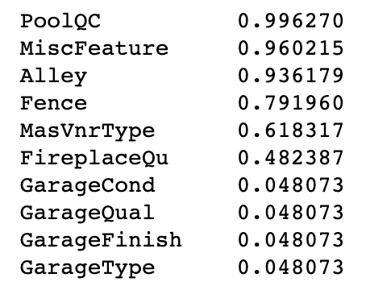
Exploratory Data Analysis:
Removed Nominal Variables With Less Than 20% of Unique observations (left)
Removed Numeric Features With Less Than 20% of Unique Observations (right)

Slide 8
Exploratory Data Analysis:
Generated New Features
Combined Number of Bathrooms in the Basement: “BsmtFullBath” and “BsmtHalfBath”
Created Cost Per Square-Foot (pic of the dataset with the said features)

Slide 9
Exploratory Data Analysis:
Removed Abnormal Sales
Included sales that were completed under 'normal' circumstances. The other type of sales (foreclosure, short sale, etc...) only account for 6% of the observations and are outside the scope of this work.( Insert code)

Slide 10
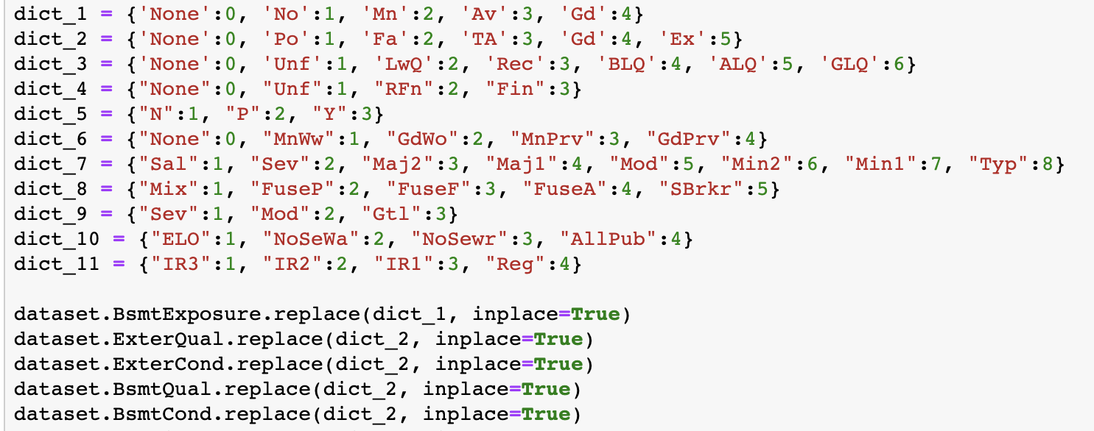
Exploratory Data Analysis:
Converted Ordinal Variables to Numeric

Slide 11
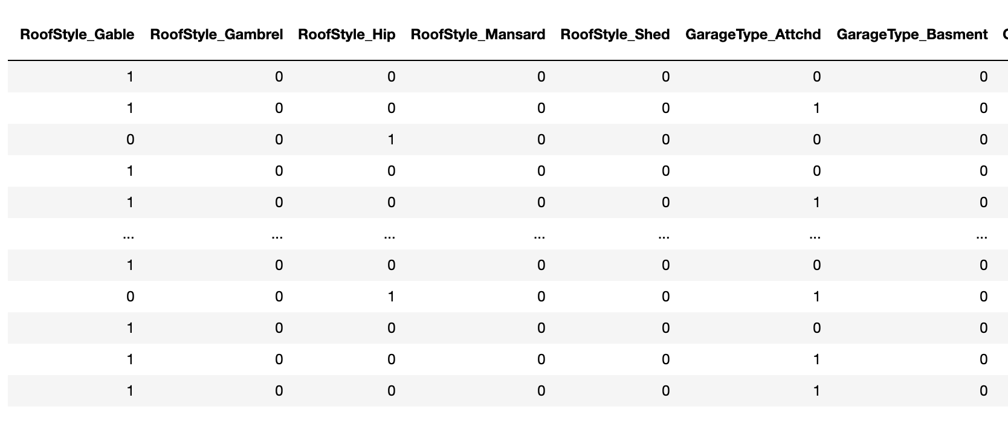
Exploratory Data Analysis:
Dummified Nominal Variables

Slide 12
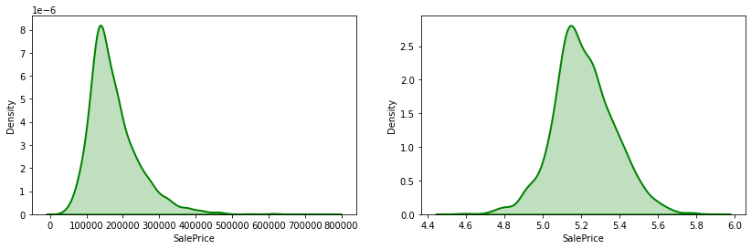
Exploratory Data Analysis:
Checked for Normality: Dependent Variables
Applied log(10) to the Sale Price, our predictor variable (graph on the right)

Slide 13
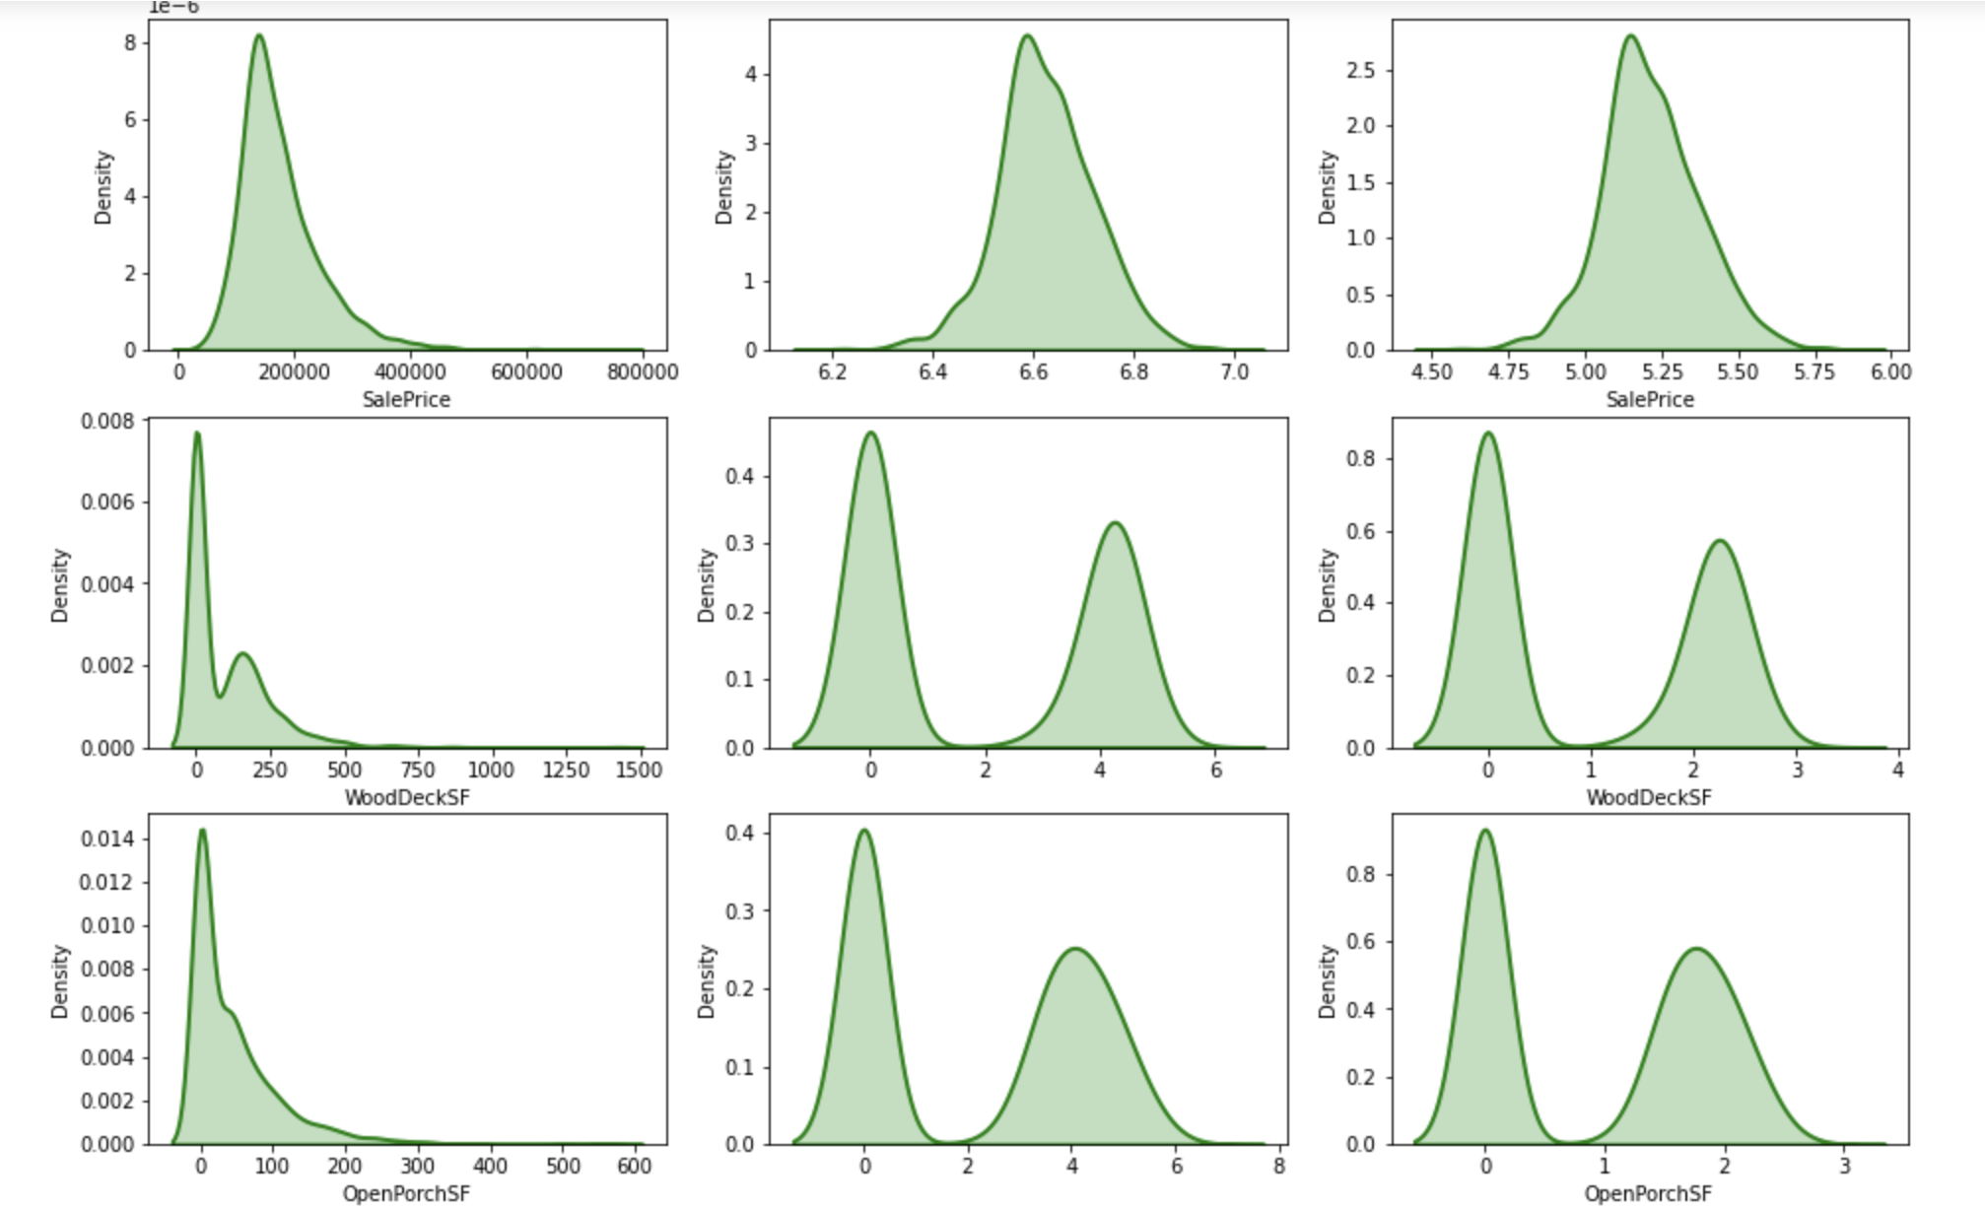
Exploratory Data Analysis:
Checked for Normality: Independent Variables
Found 3 variables that would improve the distribution if log(10) function was applied to them. (the variables are: GrLivArea, 1stFlfSF and Lot Area)

Slide 14
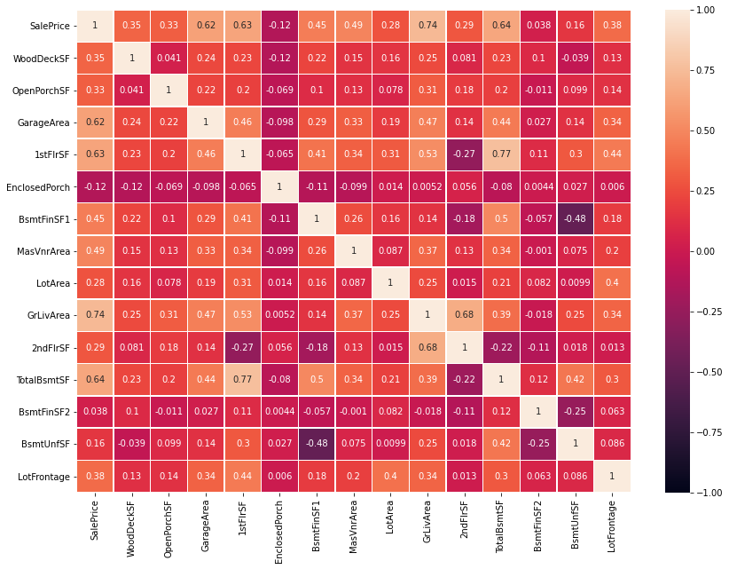
Exploratory Data Analysis:
MultiCollinearity: Correlation Matrix for Continuous Variables
Correlation Against Target Variable (SalePrice):
 | SalePrice
SalePrice | 1.000000
GrLivArea | 0.736036
TotalBsmtSF | 0.642354
1stFlrSF | 0.634672
GarageArea | 0.621900
MasVnrArea | 0.486620
BsmtFinSF1 | 0.454087
LotFrontage | 0.382420
WoodDeckSF | 0.350127
OpenPorchSF | 0.326489
2ndFlrSF | 0.293338
LotArea | 0.275066
BsmtUnfSF | 0.159724
EnclosedPorch | 0.117988
BsmtFinSF2 | 0.038346

Slide 15
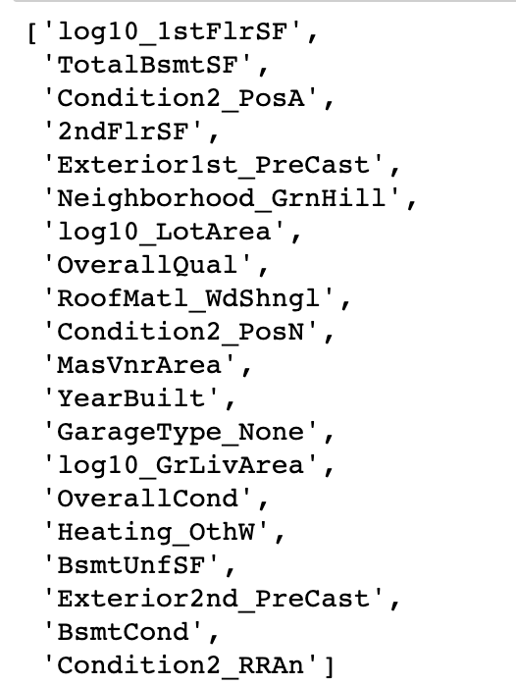
Exploratory Data Analysis:
We used Lasso to determine which features will go into our model

Slide 16
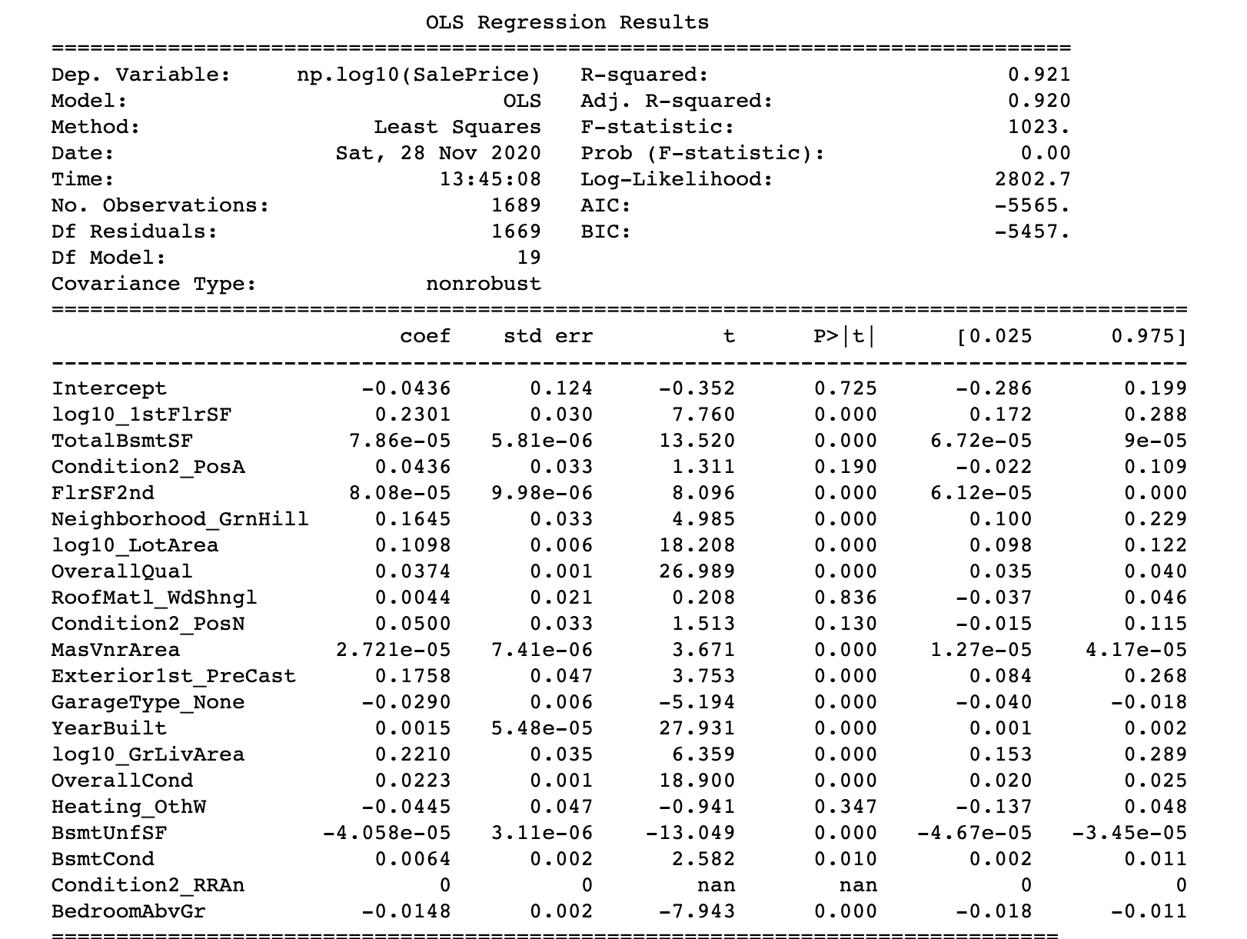
Exploratory Data Analysis: We evaluated p-values and R-squared using Statmodel to examine the significance of features

Slide 17
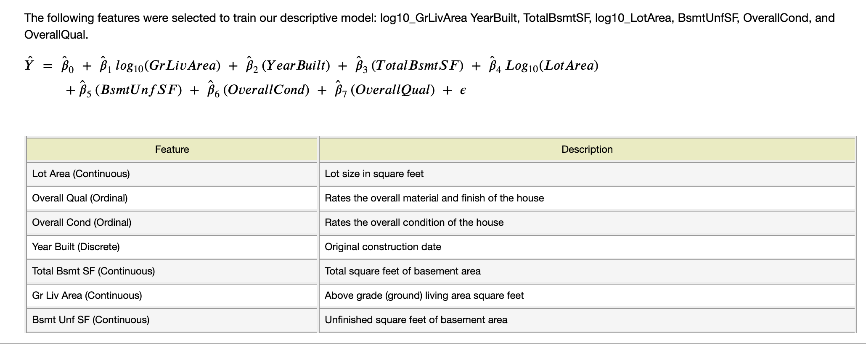
Exploratory Data Analysis:
We used Descriptive Model for our study

Slide 18
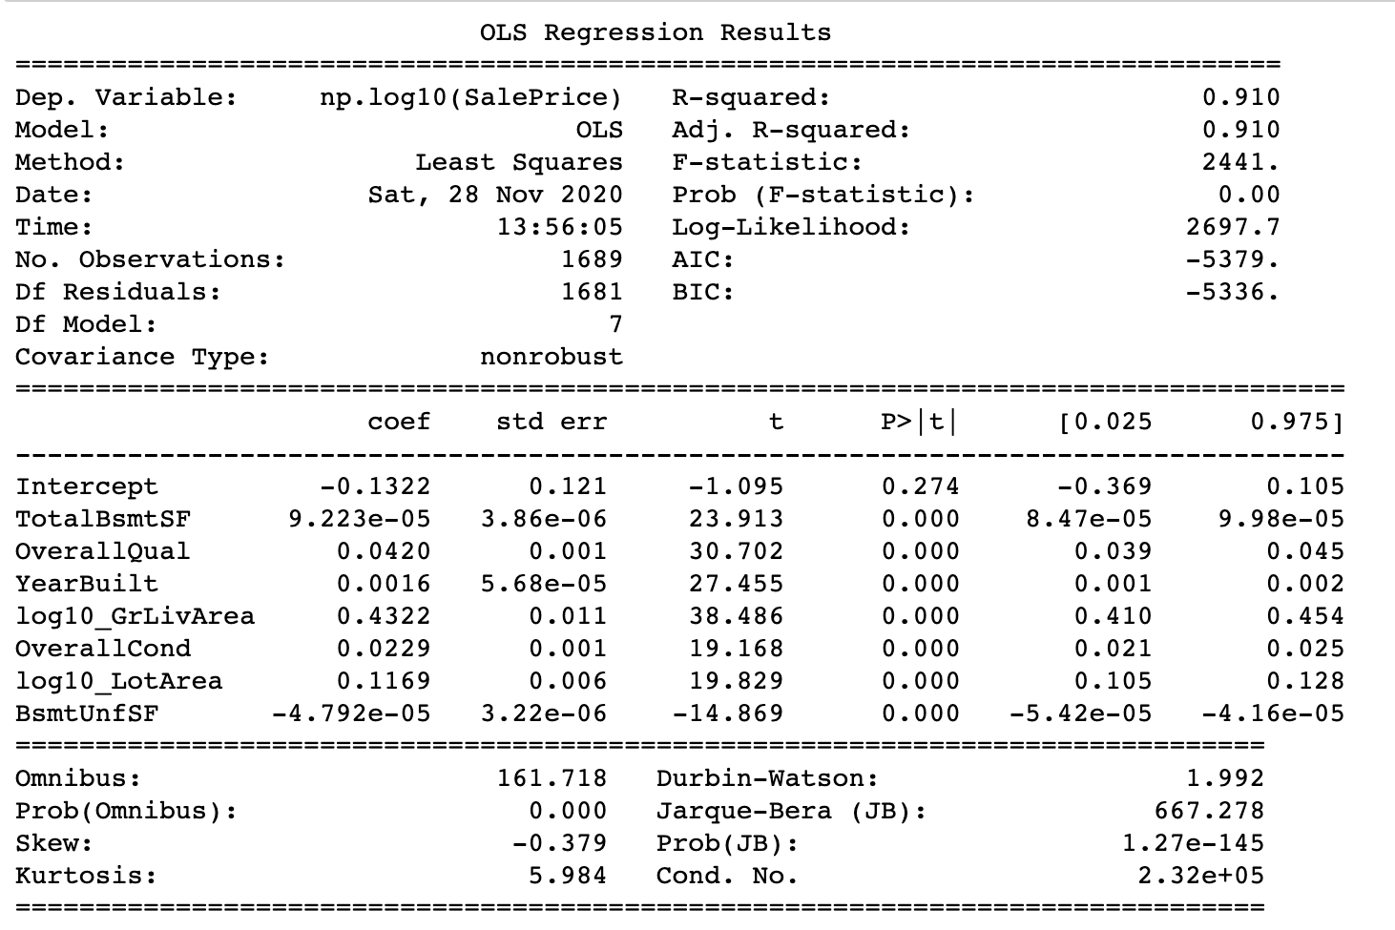
We narrowed the number of features to 7
Exploratory Data
Analysis:

Slide 19
Feature Analysis

Slide 20
Roof Material and Fence Quality

Slide 21
Roof Material
How does the material used for the roof of the house affects the sale price?
Roof Material
Clay or Tile
Standard (Composite) Shingle
Membrane
Metal
Roll
Gravel & Tar
Wood Shakes
Wood Shingles

Slide 22
Roof Material
Number of houses grouped by roof material
Roof Material | Percentage (%)
Standard (Composite) Shingle | 98.673850
Membrane | 0.041442
Metal | 0.041442
Roll | 0.041442
Gravel & Tar | 0.621633
Wood Shakes | 0.290095
Wood Shingles | 0.290095

Slide 23
Roof Material
Analyzing house year built grouped by roof material
Roof Material | Minimum | Maximum | Average
Standard (Composite) Shingle | 1872 | 2010 | 1969
Membrane | 1954 | 1954 | 1954
Metal | 1969 | 1969 | 1969
Roll | 1948 | 1948 | 1948
Gravel & Tar | 1940 | 2004 | 1963
Wood Shakes | 1967 | 1993 | 1979
Wood Shingles | 1892 | 1994 | 1966

Slide 24
Roof Material
Number of houses built after 1990 grouped by roof material
Roof Material | Percentage of Houses
CompShg | 99.64
Tar&Grv | 0.12
WdShake | 0.12
WdShngl | 0.12

Slide 25
Roof Material
Findings
We are not able to determine from the data available how much the value of the house would increase or decrease depending on the roof material.
Should the house roof material require replacement we recommend to use standard shingles. Almost all the houses in our dataset have standard shingles.

Slide 26
Fence Quality
How much does the quality of the fence will affect the sale price of the house?
Rating | Description
4 | Good Privacy
3 | Minimum Privacy
2 | Good Wood
1 | Minimum Wood/Wire
0 | No Fence

Slide 27
Fence Quality
Houses built after 1990
Fence Rating | Percentage of Houses
Good Privacy | 2.99
Minimum Privacy | 1.79
Good Wood | 0.48
No Fence | 94.74

Slide 28
Fence Quality
Number of Houses with a Fence
Fence Rating | Percentage (%)
Good Privacy | 4.43
Minimum Privacy | 11.86
Good Wood | 4.1
Minimum Wood/Wire | 0.41
No Fence | 79.2

Slide 29
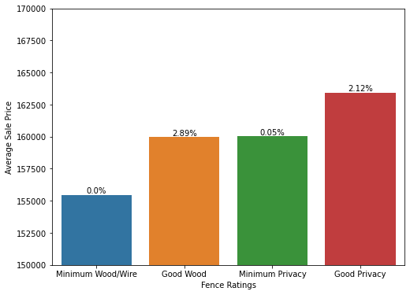
Fence Quality
Change in house value depending on the fence quality
Fence Type | Sale Price (avg, $)
Minimum Wood/Wire | 155,466.8
Good Wood | 159,953.1
Minimum Privacy | 160,036.6
Good Privacy | 163,425.55

Slide 30
Fence Quality
Findings
We are not able, given the data available, to determine how much value would be added to a house by installing a new fence. 80% of the houses in the dataset do not have fences.
If we take a look at only those houses with a fence we can see a trend:
Houses with Minimum Wood/Wire fences have the lowest values among houses with a fence.
Replacing a Minimum Wood/Wire fence with a Good Wood or Minimum Privacy fence can yield almost a 3% increase in the value of the house.
The best gains were observed when a Minimum Wood/Wire fence was replaced by a Good Privacy fence, a ~5% increase in the value of the house. For example, a house priced at $150,000.00 with a Minimum Wood/Wire fence, according to the data available, can increase its sale price to $157,500.00 by replacing the existing fence for a Good Privacy fence.
It is clear from the data that most houses do not have a fence. Adding a fence to a house that does not have one is not recommended given the data available. However, it should be considered case by case.

Slide 31
Exterior and Garage

Slide 32
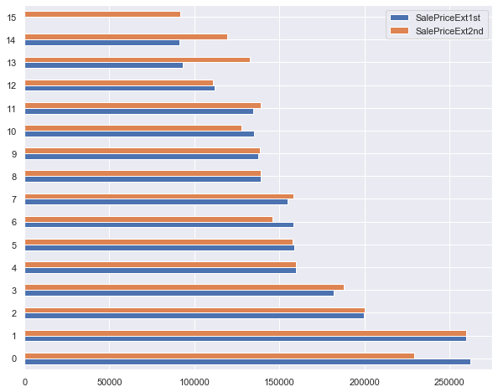
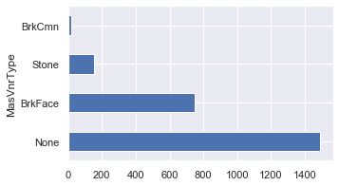
Exterior
Exterior In Mason Veneer Type and Mason Veneer Area (MasVnrType and MasVnrArea) the majority of the data appears as None, therefore doesn’t carry much significance.
1st and Exterior2nd show similar yield when the typos in Exterior2nd are fixes. Typos were: ‘Wd Shng’ : ‘WdShng’, ‘CmentBD’ : ‘CemntBD’, ‘Brk Cmn’ : ’Brk Comm’
material
SalePrice(avg)

Slide 33
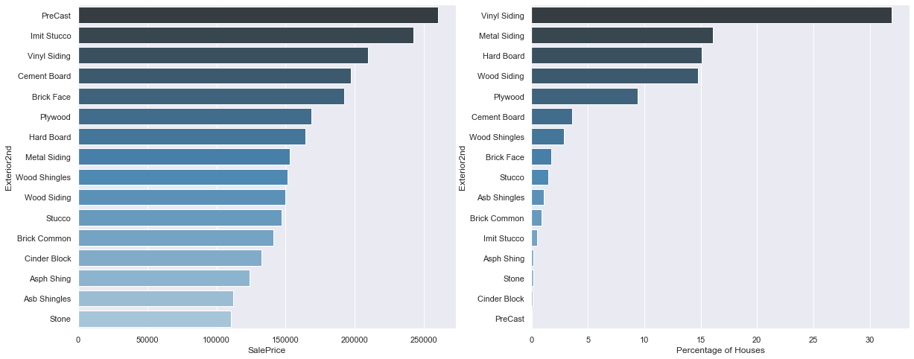
We explored Exterior2nd feature deeper. The mean SalePrice per Exterior feature displayed on the left. The Percentage of Houses that have that Exterior material are on the right
Exterior
We grab 10 houses with Plywood Exterior and use our model to predict the prices for these houses.
Next, we predict the prices for these same houses if they had Vinyl Exterior instead of Plywood.
Our model yields: 0.9158010328166403

Slide 34
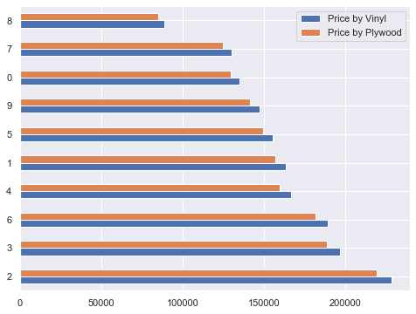
Compared Predicted Value of the houses with Plywood Exterior with Predicted Value of the same houses if they had Vinyl exterior. Each house with Plywood exterior shows an increase in price if it had Vinyl exterior
Exterior
 | Price by Plywood $ | Price by Vinyl $ | Difference
0 | 129287.19 | 134746.74 | 5459.55
1 | 156843.44 | 163466.64 | 6623.20
2 | 219061.00 | 228311.53 | 9250.53
3 | 188527.81 | 196488.98 | 7961.17
4 | 159762.70 | 166509.18 | 6746.48
5 | 149058.09 | 155352.53 | 6294.44
6 | 181585.60 | 189253.61 | 7668.01
7 | 124476.14 | 129732.53 | 5256.39
8 | 85087.79 | 88680.89 | 3593.10
9 | 141097.01 | 147055.27 | 5958.26
Houses
SalePrice(avg)

Slide 35
Exterior: Conclusions
The cost of material taken into consideration we cannot suggest to change Plywood for Vinyl if the Plywood exterior is in good condition
However, if it’s deteriorating and requires change, the change to Vinyl will bring a return on an investment assuming there’s permission for it

Slide 36
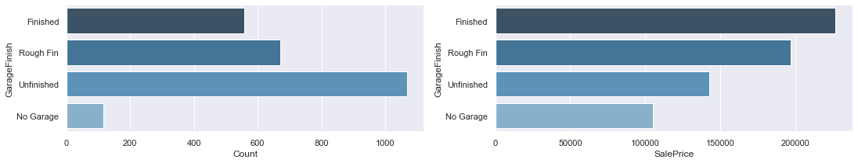
Garage Finish
After a closer look at all the Garage features we chose to evaluate the Garage Finish
The count of Finished, Rough Finish, Unfinished and No Garage displayed on the left. The mean Sale Price for Finished, Rough Finish, Unfinished and No Garage on the right
By the same logic we grab 10 houses with Unfinished Garage and use our model to predict the prices for these houses. Next, we predict the prices for these same houses if they had Finished Garage instead of Unfinished.
Again, our model yields: 0.9154034290784837

Slide 37
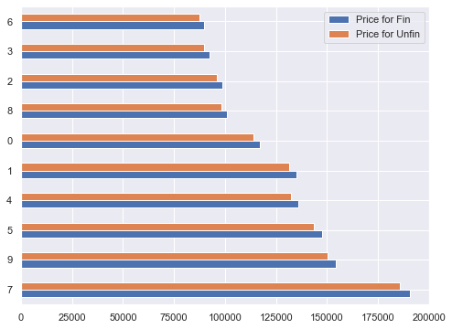
We evaluated prices for houses with Unifinished Garages and predicted prices for the same houses if their Garages were Finished. The houses are predicted to increase in price if the said Garages were Finished
Garage
Finish
 | Price for Unfin $ | Price for Finished $ | Difference
7 | 185629.90 | 190662.88 | 5032.98
9 | 150367.72 | 154444.64 | 4076.92
5 | 143491.54 | 147382.02 | 3890.48
4 | 132237.32 | 135822.67 | 3585.35
1 | 131259.17 | 134818.00 | 3558.83
0 | 113766.68 | 116851.23 | 3084.55
8 | 98434.30 | 101103.15 | 2668.85
2 | 96028.32 | 98631.94 | 2603.62
3 | 89853.38 | 92289.57 | 2436.19
6 | 87298.49 | 89665.41 | 2366.92
Houses
SalePrice of a house (avg)

Slide 38
Garage Finish: Conclusions
The Unfinished Garage turned into Finished yields a return on the investment and could be considered for the future repairs

Slide 39
Basement Features

Slide 40
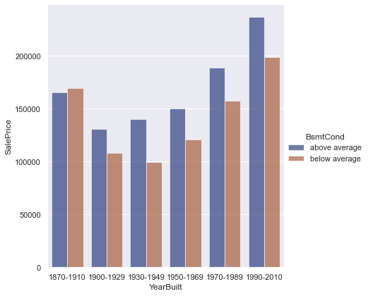
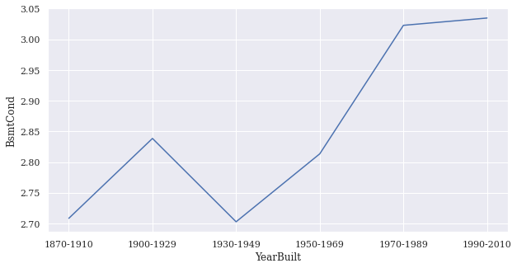
Basement Features
Sale price By Year built
Basement Condition
Basement condition By Year built

Slide 41
Basement Features
Good Condition Basement
$107983.46
$122884.71
$88004.76
$229399.94
$181418.45
$83478.17
$129508.43
$130745.34
$191767.04
$123130.15
Low Condition Basement
$113429.95
$129082.78
$92443.56
$240970.45
$190568.86
$87688.65
$136040.59
$137339.89
$201439.41
$129340.61
Basement Condition

Slide 42
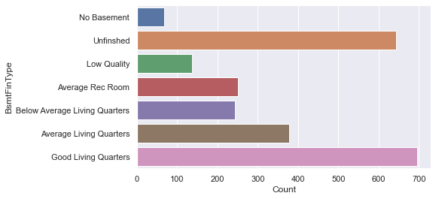
Basement Features
Basement Type
Basement types
Basement type
Unfinished and Good Living Quarters has similar number of houses. .
Analyze between two values.

Slide 43
Basement Features
Unfinished Basement
$111714.96
$126187.10
$129978.74
$94384.43
$230702.09
$176027.34
$87986.12
$131470.10
$133945.75
$199197.32
Good Living Quarters
$117037.72
$132199.39
$136171.69
$98881.46
$241694.10
$184414.32
$92178.30
$137734.11
$140327.71
$208688.26
Basement Type

Slide 44
Fireplace Features

Slide 45
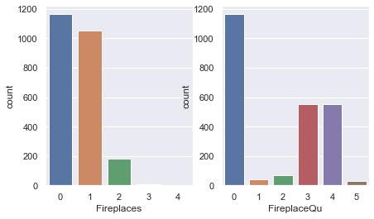
Fireplace features
Number of fireplaces
Basement type
The number of fireplaces are “0” or “1”.
Analyze between two values.

Slide 46
Fireplace features
No Fireplaces
$112127.73
$128676.78
$93912.06
$231627.60
$128989.30
$179166.81
$88686.26
$131713.56
$136523.97
$199973.84
1 Fireplace
$116638.44
$133853.24
$134178.33
$97689.99
$240945.60
$186374.40
$92253.96
$137012.18
$142016.11
$208018.46
Number of fireplaces

Slide 47
Heating, Central Air, Kitchen Quality

Slide 48
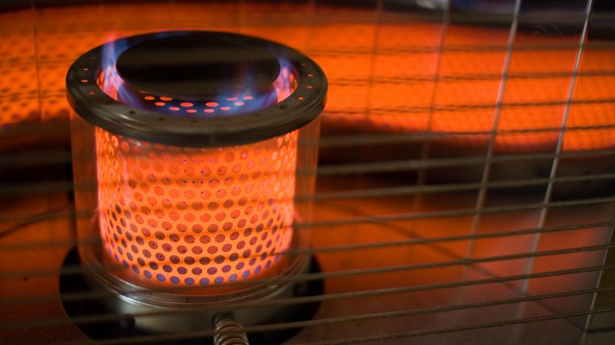
Heating Quality
Evaluate the condition of heating
Interpret how quality of the feature impacts price.
Rating | Quality | Description
5 | Ex | Excellent
4 | Gd | Good
3 | TA | Average/Typical
2 | Fa | Fair
1 | Po | Poor
Heating Quality | Percentage of Houses
Poor | 0.04
Fair | 3.31
Average/Typical | 30.08
Good | 17.48
Excellent | 49.06

Slide 49
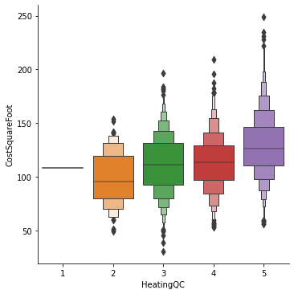
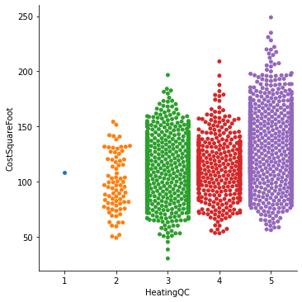
Heating: Cost Per Square Foot
Quality of heating system impacts price of the home
Most homes have a heating rating of 3 or higher. (Or Average and up)
Boxen Plot on the left shows the distribution and averages.
Swarm plot on the right shows frequency.
HeatingQC | Sale Price ($) | GrLivArea (sqft) | Cost Per Square Foot($)
5 | 206841.93 | 1613.84 | 129.12
4 | 155575.78 | 1402.72 | 113.64
3 | 141821.86 | 1317.72 | 111.86
2 | 125515.22 | 1309.72 | 98.48
1 | 87000.00 | 803.00 | 108.34

Slide 50
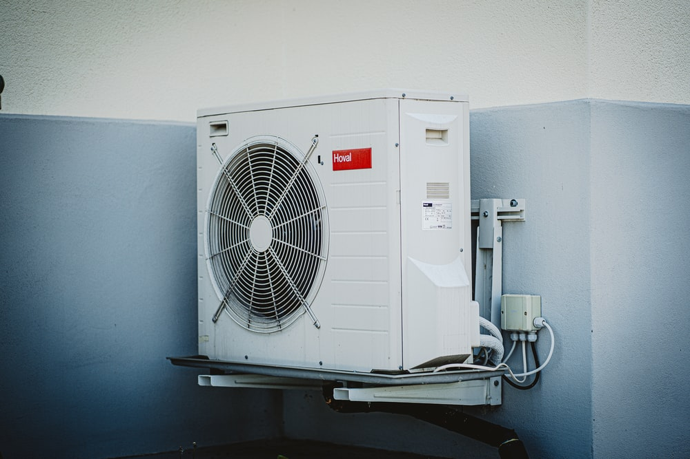
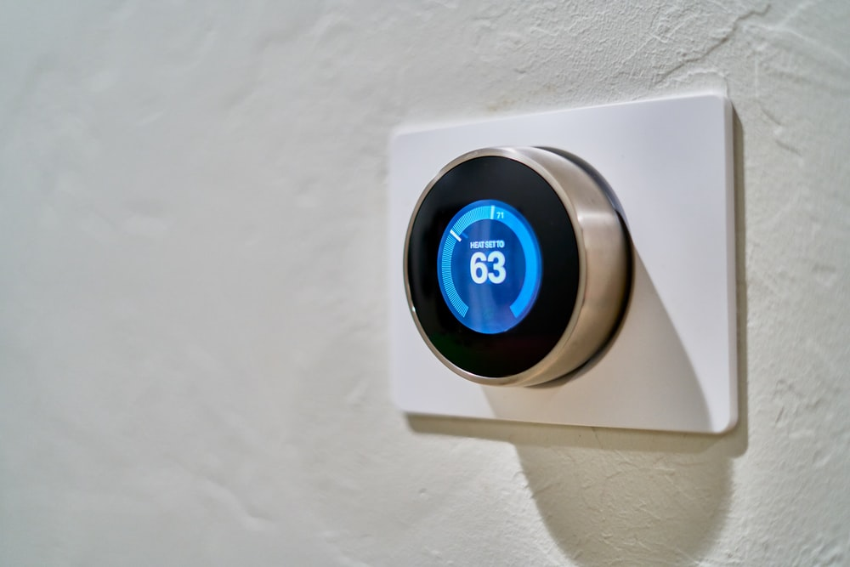
Central Air
How does central air impact the value of a home?
Central Air Present | Percentage of Houses
No | 6.34
Yes | 93.66
Vast majority of homes have a central air unit present (Over 93%)

Slide 51
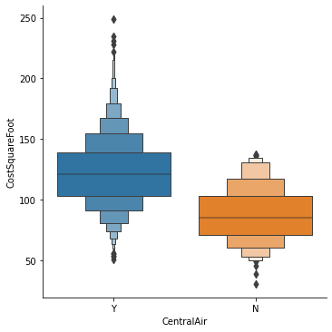
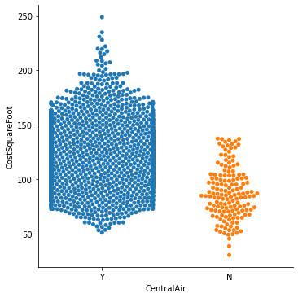
Central Air: Cost Per Square Foot
Having Central Air System greatly increases value of home.
Most homes have a central air unit present.
Boxen Plot on the left shows the distribution and averages.
Swarm plot on the right shows frequency.
Central Air Present | Sale Price($) | GrLivArea(sqft) | Cost Per Square Foot($)
Y | 180370.90 | 1491.64 | 122.42
N | 104617.53 | 1267.12 | 87.40

Slide 52
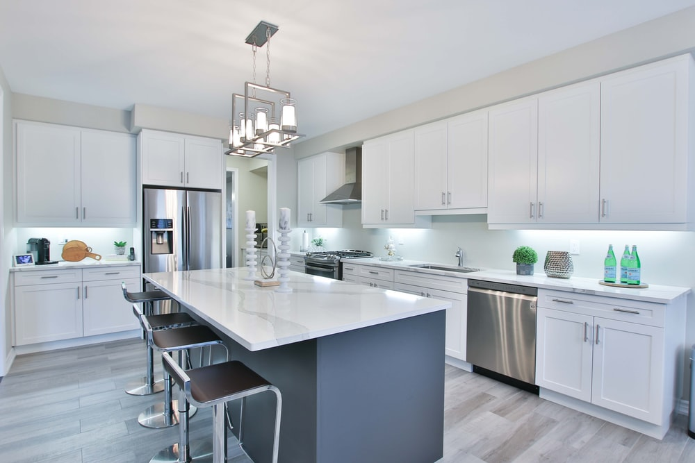
Kitchen Quality
Evaluate the condition of the Kitchen
Interpret how quality of the feature impacts price.
Rating | Quality | Description
5 | Ex | Excellent
4 | Gd | Good
3 | TA | Average/Typical
2 | Fa | Fair
1 | Po | Poor
Kitchen Quality | Percentage of Houses
Poor | 0.041442
Fair | 2.527973
Average/Typical | 53.626191
Good | 38.997099
Excellent | 4.807294

Slide 53
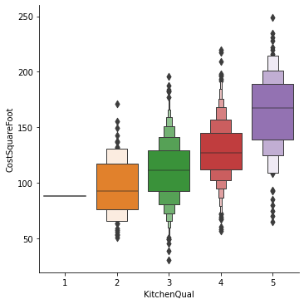
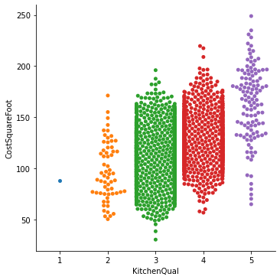
Kitchen Quality: Cost Per Square Foot
Quality of Kitchen has direct impact on price of home
Most homes have a Typical/ Average or Good rating
Boxen Plot on the left shows the distribution and averages.
Swarm plot on the right shows frequency.
Kitchen Quality | Sale Price ($) | GrLivArea (sqft) | Cost Per Square Foot ($)
5 | 327006.53 | 2017.65 | 163.56
4 | 207739.89 | 1639.31 | 128.86
3 | 141828.69 | 1326.27 | 111.12
2 | 108113.11 | 1162.80 | 97.19
1 | 107500.00 | 1224.00 | 87.82

Slide 54
Analysis of Ames Housing data: Conclusions
Kitchen Quality significantly impacts the price of the home.
Replacing poor quality fence with a higher quality fence can yield almost 5% increase in the value of the house.
Replacing poor quality Exterior material may increase the value of the house from 4% to 5% .
Finishing Garage could increase the value of the house from 3% to 4%.
Improving the Basement condition does not increase the sale price of the house.
Houses with fireplaces priced higher when compared to houses that do not have a fireplace.

